Slide 1

Introduction to Mutagens and DNA

Slide 2
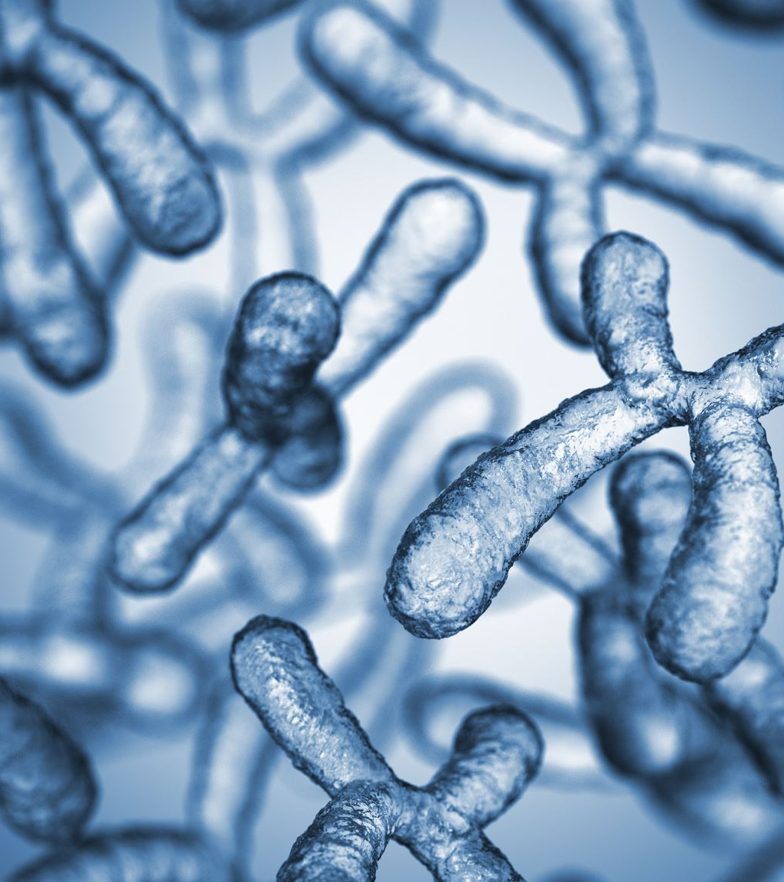
Mutagens are agents that can induce changes, or mutations, in the genetic material of an organism
Importance of Understanding Mutagens: Understanding mutagens is crucial for various fields including genetics, medicine, and environmental science

Slide 3
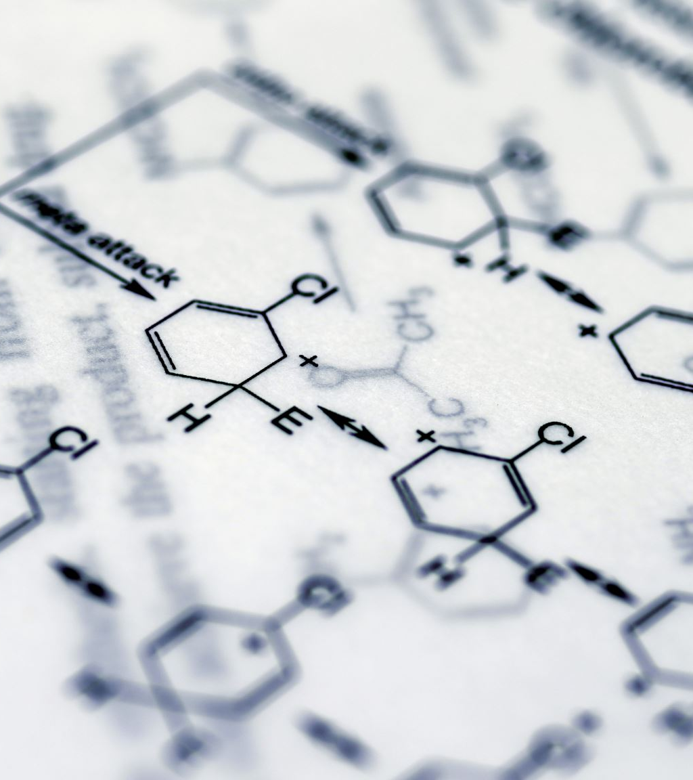
Types of Mutagens
Chemical Mutagens: Chemical mutagens are substances that can interact with DNA, leading to alterations in its structure
Physical Mutagens: Physical mutagens exert their effects on DNA through physical means rather than chemical interactions
Biological Mutagens: Biological mutagens are living organisms that can introduce mutations into DNA

Slide 4
Mechanisms of Mutagenesis
Point Mutations: Point mutations involve changes in a single nucleotide base pair within the DNA sequence
Frameshift Mutations: Frameshift mutations occur when nucleotides are inserted or deleted from the DNA sequence in a quantity that is not a multiple of three
Chromosomal Mutations: Chromosomal mutations involve changes in the structure or number of chromosomes

Slide 5
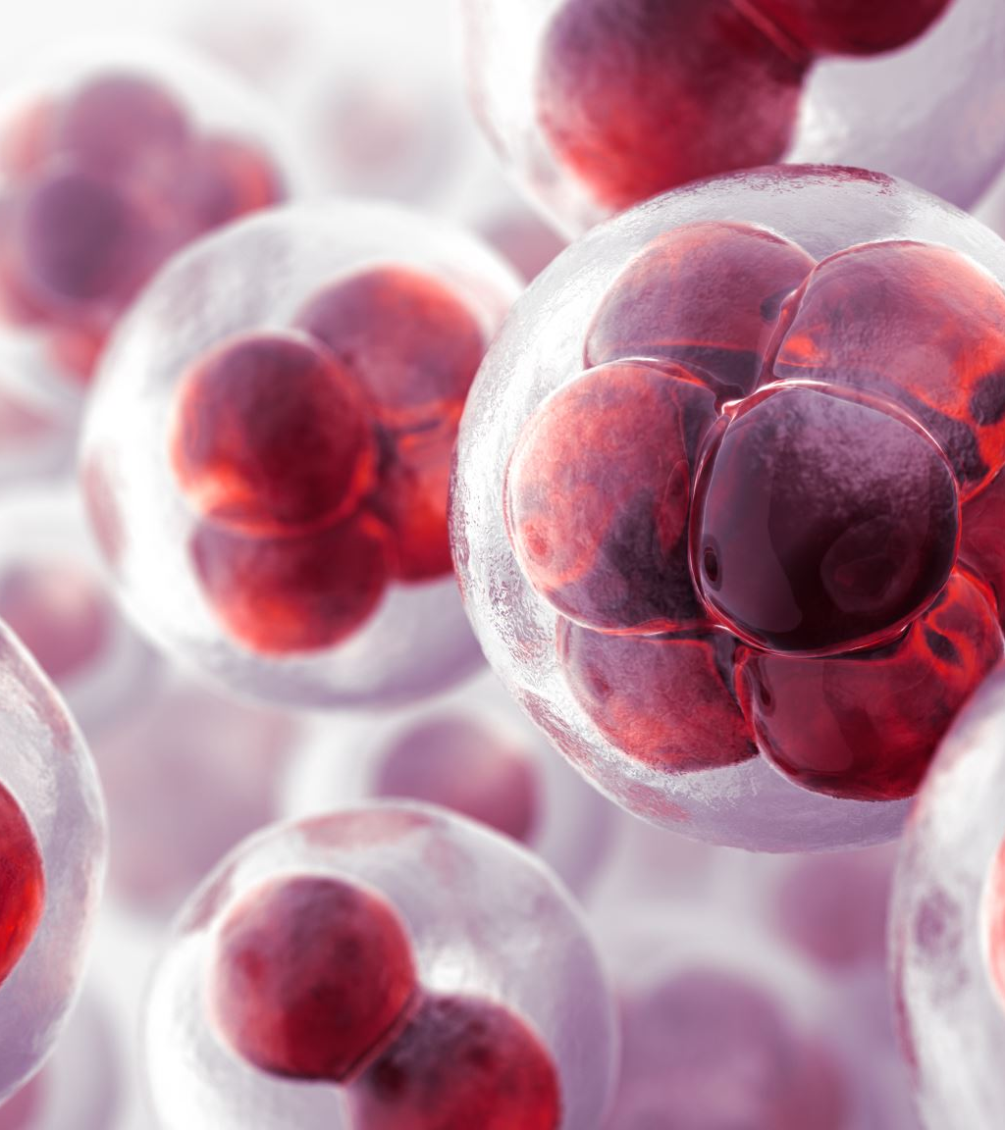
Effects of Mutations
Silent Mutations: Silent mutations are those that occur in regions of the genome that do not encode proteins or do not change the amino acid sequence of the protein
Missense Mutations: Missense mutations result in a change in a single amino acid within the protein sequence
Nonsense Mutations: Nonsense mutations introduce a premature stop codon into the mRNA sequence, resulting in the premature termination of protein synthesis
Frameshift Mutations: Frameshift mutations can have drastic effects on protein structure and function due to the alteration of the reading frame of the genetic code
Chromosomal Mutations: Chromosomal mutations can lead to genetic disorders, developmental abnormalities, or an increased risk of cancer

Slide 6

Implications and Conclusion
Assessing Environmental and Occupational Hazards: Understanding mutagens is essential for assessing the potential risks posed by environmental pollutants, occupational exposures, and lifestyle factors
Cancer Research and Treatment: Mutagens play a critical role in the development of cancer
Public Health Policies and Regulations: Awareness of mutagenic hazards informs the development of public health policies and regulations aimed at minimizing exposure to mutagens and reducing the incidence of genetic disorders and cancer
Continued Research and Vigilance: Mutagenesis is a complex and ongoing area of research, with new mutagens and mechanisms continually being discovered

Slide 7
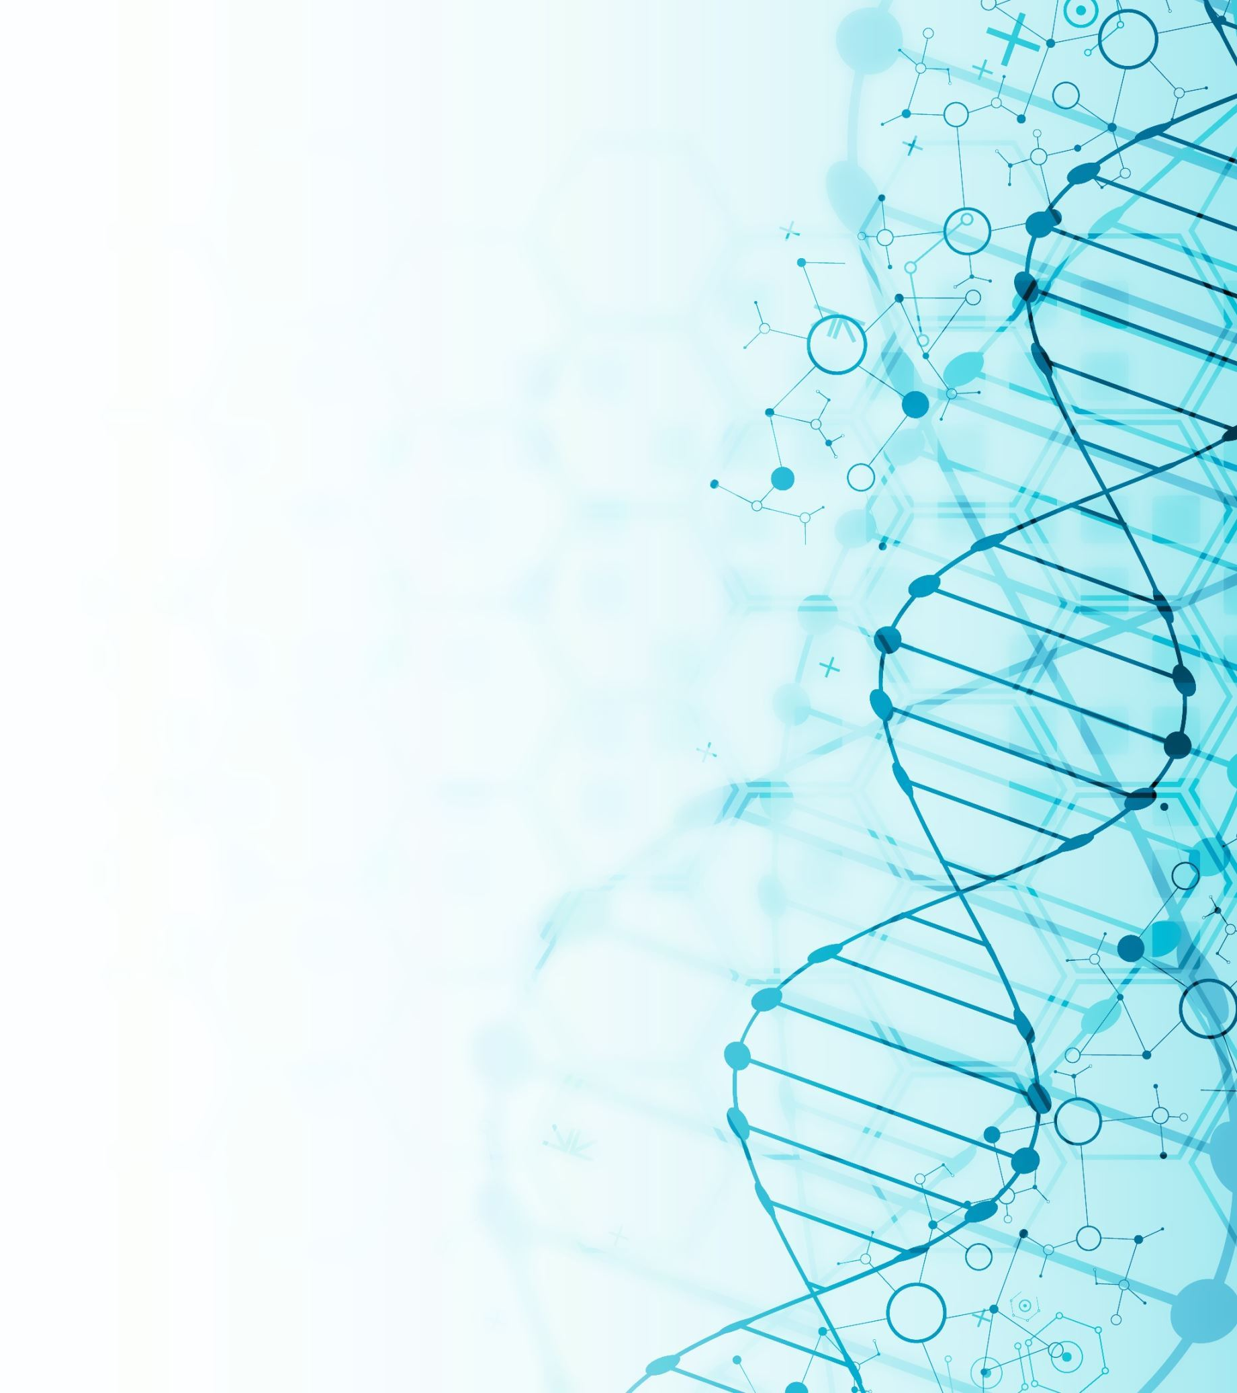
Conclusion
Understanding mutagens and their effects on DNA is essential for addressing a wide range of biological, medical, and environmental challenges

